Slide 1
Raspberry Pi Button Switch Control
1.27.2017

Slide 2
Agenda
Learn how to use one GPIO pin as input, another GPIO pin as output. Use input state to control LED on/off.
How to connect button switch

Slide 3
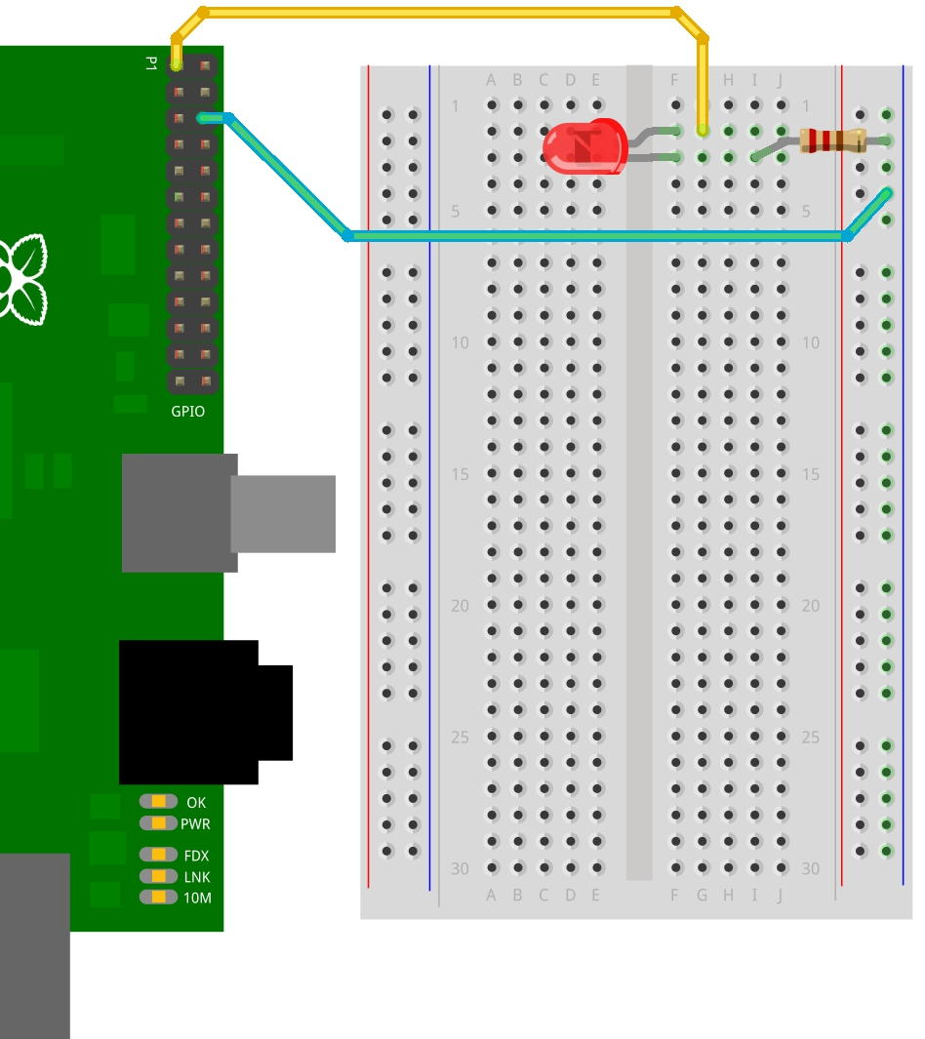
Circuit Layout

Slide 4
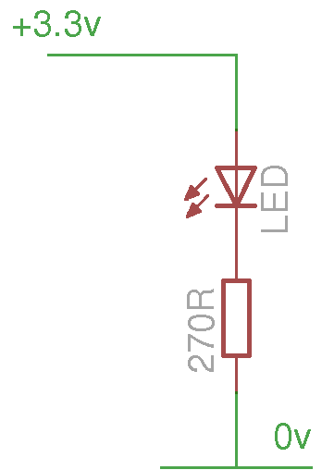
Circuit Layout
LEDs == Light Emitting Diodes
only pass electricity one way
long leg goes to the plus side shorter leg to the negative (or 0v) side.
Or, flat as a minus sign and connect that to the 0v side of the circuit.

Slide 5
Button Switch
Button Switch
“pressed” or “not pressed”
If GPIO PIN 17 is configured as “input” to probe the button switch’s state, how to define “high” and “low”.
What’s the initial state of PIN 17 if nothing is connecting? HIGH or LOW?
Use “pull-down resistor” to initialize PIN 17 state; otherwise PIN 17 state is undetermined (floating)

Slide 6
Pull-down resistor
Pull-down resistor is often used with button and switches.
With a pull-down resistor, the input pin will read a low state when button is not pressed; when the button is pressed, the pin will read a high state.
Keep in mind, a resistor is required otherwise it could be “short”.

Slide 7
Pull-up resistor
“Pull-up”:
pull up GPIO state to high when circuit is open.
10k resistor connecting on “3.3v”-end
GPIO.setup(inputPIN, GPIO.IN, pull_up_down=GPIO.PUD_UP)
“Pull-down”:
pull down GPIO state to low when circuit is open.
10k resistor connecting on “ground”-end
GPIO.setup(inputPIN, GPIO.IN, pull_up_down=GPIO.PUD_DOWN)

Slide 8
Practice 1
Pull-down resistor
Connect the circuit
Python programming

Slide 9
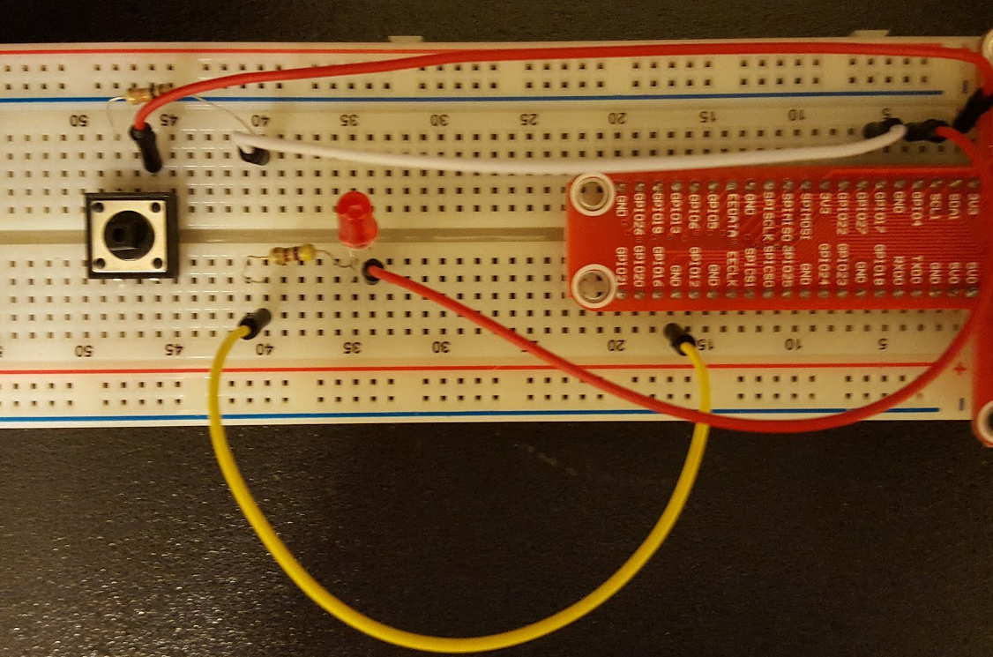
Sample Circuit

Slide 10
Python code
# import the GPIO module
import RPi.GPIO as GPIO
# use board pin naming convention
GPIO.setmode(GPIO.BOARD)
# define PIN
inputPIN = 11
outputPIN = 7
# pull down resistor
GPIO.setup(inputPIN, GPIO.IN, pull_up_down=GPIO.PUD_DOWN)
# setup pin 7 to output - control LED
GPIO.setup(outputPIN, GPIO.OUT)
# intialize pin 7 state as low
GPIO.output(outputPIN, 0)
try:
while True:
if (GPIO.input(inputPIN) == 1):
GPIO.output(outputPIN, 1)
else:
GPIO.output(outputPIN, 0)
except KeyboardInterrupt:
GPIO.cleanup()

Slide 11
Practice 2
Pull-up resistor
Connect the circuit
Python programming

